Slide 1
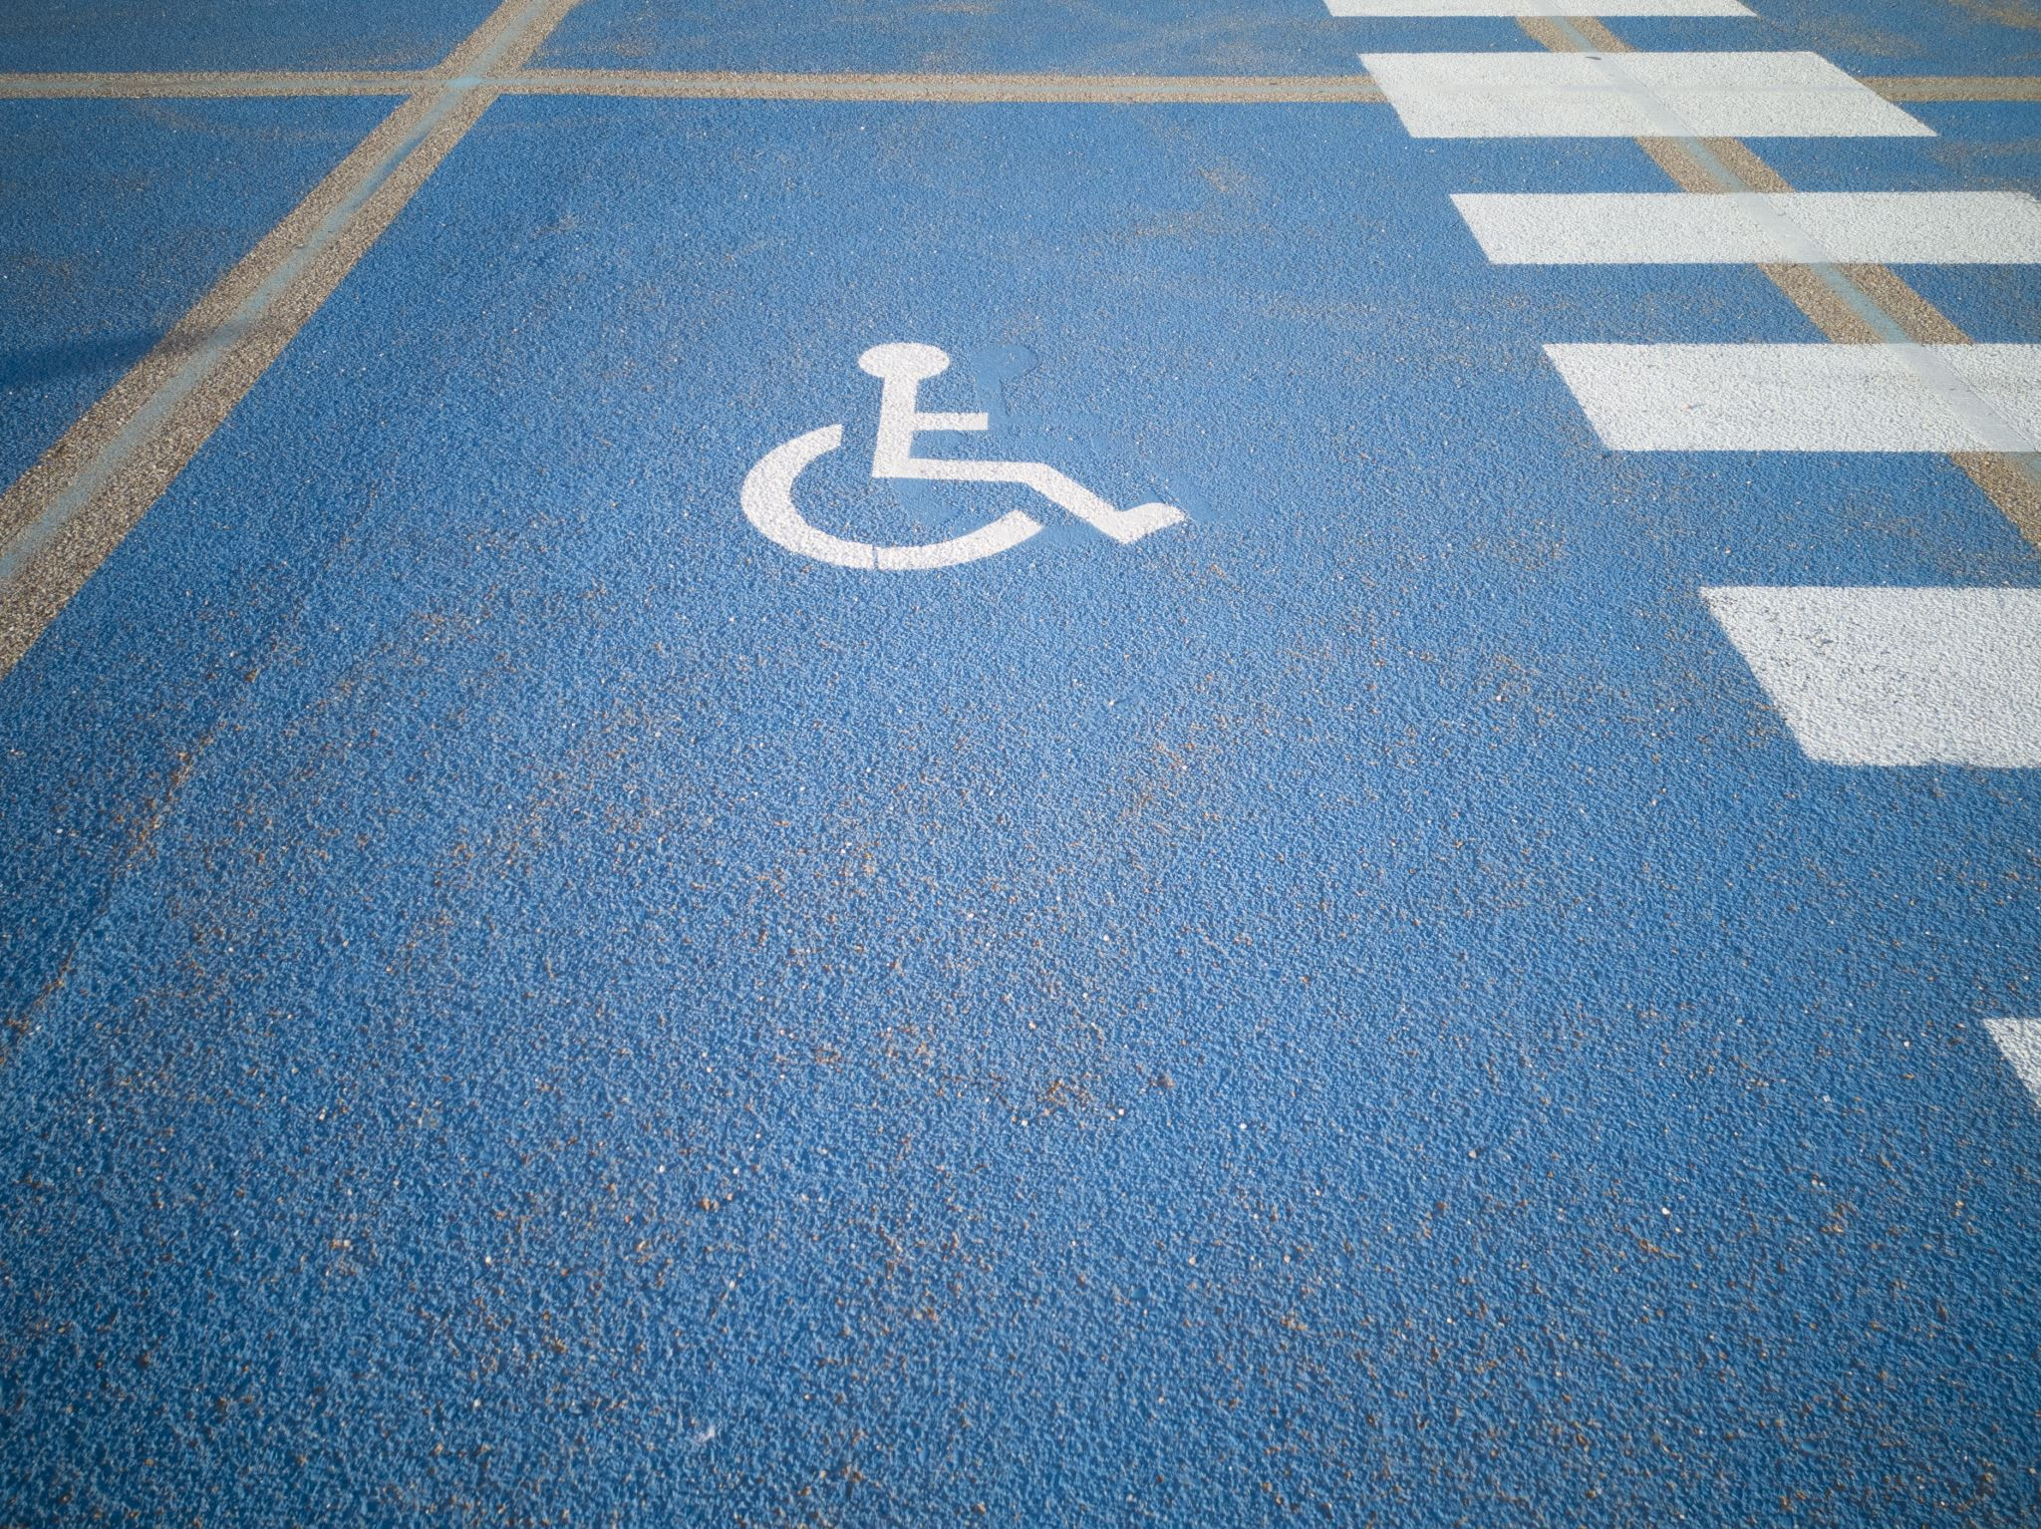
ACCESSIBILITY
PROF AUGUSTINA NAAMI
ASSOCIATE PROFESSOR
DEPARTMENT OF SOCIAL WORK
UNIVERSITY OF GHANA

Slide 2
In this section:
Overview of Disability
General Accessibility
Web Accessibility Guidelines and Scenarios
Why Accessibility Matters
Digital accessibility considerations
Benefits of web accessibility
Conclusion
Notes:
Goal: climate change, resilience and adaptability
In simple terms your solution should be usable by all
Everyone should benefit from your final product, men, women, PWDs etc

Slide 3
OVERVIEW OF DISABILITY

Slide 4
DEFINING DISABILITY
Persons with Disability Act 715 “person with disability” means an individual with a physical, mental or sensory impairment including a visual, hearing or speech functional disability which gives rise to physical, cultural or social barriers that substantially limit one more of the major life activities of that individual”
United Nations Convention on the Rights of Persons with Disabilities (UNCRPD) “Persons with disabilities include those who have long-term physical, mental, intellectual or sensory impairments which in interaction with various barriers may hinder their full and effective participation in society on an equal basis with others.”

Slide 5
Overview of Disability
Approximately 1.3 billion (16%) people worldwide live with some form of disability, with low-income countries being home for with 80% of them (WHO, 2022).
Inclusion of persons with disabilities continues to be challenging due to stigma (World Bank, 2021), barriers to accessibility (Naami, 2023), and policy-practice gap (Meekosha & Soldatic, 2011).
5 million Ghanaians are estimated to live with disabilities, which is a huge number that cannot be ignored in development agendas
Persons with disabilities are less likely to have education, employment, earn regular income.
Disability related expenses are also high and very few social protection benefits exits
Persons with disabilities are and more likely to live in poverty (WHO, 2011).
Notes:
1. Accessibility is a huge issues and barriers to accessility is a hugh challenge for PWDs

Slide 6
Types of Disability
Visual disabilities
Blindness, low vision, and color blindness.
Hearing disabilities
Deafness and hearing loss.
Partial and total hearing loss.
Motor (physical) disabilities
Difficulty using a mouse or keyboard due to limited mobility.
Cognitive and learning disabilities
Dyslexia, memory impairments, attention disorders, and intellectual disabilities.
Speech disabilities
Conditions that affect verbal communication.
Notes:
Disability that may require accessibility support
Dyslexia is a lifelong neurodevelopmental condition that causes difficulties with
accurate and fluent word recognition, reading, and spelling.
It affects how the brain processes language, though it is completely unrelated to a person's intelligence

Slide 7
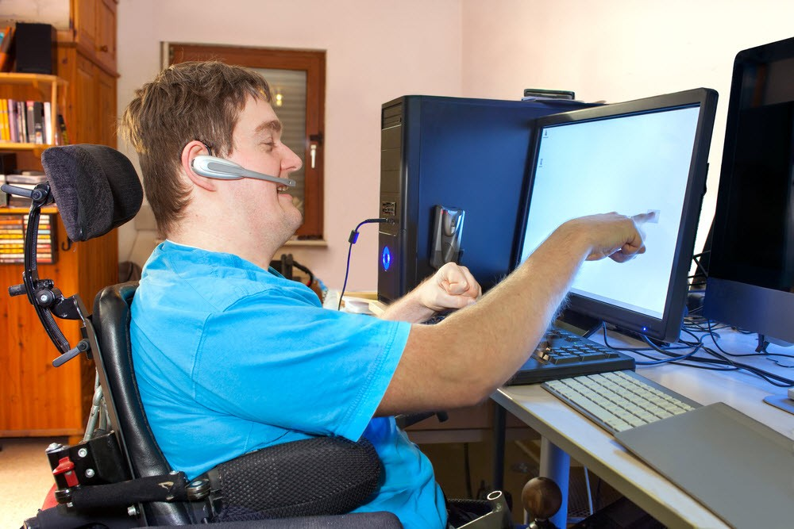
Someone with a motor disability and cannot use a mouse

Slide 8

DIVERSITY OF DISABILITY
Notes:
There are various forms of disabilities as you might have learned already.
there is diversity of needs
Therefore, one size cannot fit all

Slide 9
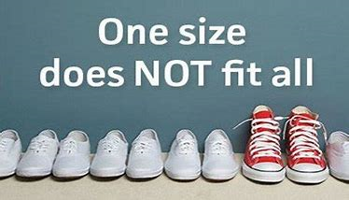
Notes:
We make adjustments because One size doesn’t fit all everybody, including those with disabilities
But even, among those with disabilities, one size will not fit all

Slide 10
WHAT IS ACCESSIBILITY?

Slide 11
Accessibility is……
Accessibility is the PRACTICE of designing:
  Products (can everyone use the item?)
  Services (can everyone receive the service)
  Environments (can everyone access the physical space)
  Digital spaces (can everyone use the app or website)
  KEY: Usable for all people as much as possible, including persons with disabilities.
Notes:
Remove barriers and create equal access
Independence
Easy use for everyone, including persons with all forms of disabilities

Slide 12
Examples
PRODUCT: An online lecture:
  SHI: live captioning or sign language interpreter/lecture transcript
  SWVI: Videos/images

Slide 13
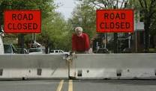
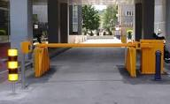
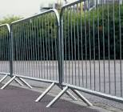
WHAT CAN YOU SEE?
Notes:
1. Why should we remove barriers?

Slide 14

Why Accessibility Matters

Slide 15
Why Accessibility Matters
Create equal opportunity
Accessibility ensures that no one is excluded/no one is left out from participating in mainstream education, employment, or commerce, banking, and everyday life
Everyone benefits from accessibility (older persons, pregnant women, mothers with toddlers using strollers, those with hidden disabilities like arthritics
Independence
Businesses can reach a larger market and increase sales, revenue and profit for 5 million PWDs/families/friends/

Slide 16
WEB ACCESSIBILITY
Notes:
Web accessibility is the practice of designing and developing websites and digital tools so that people with all types of disabilities
, including visual, auditory, physical, speech, and cognitive impairments
can fully perceive, navigate, and interact with them

Slide 17

WCAG 2.0 ACCESSIBILITY GUIDELINES

Slide 18
What is WCAG 2.0?
WCAG stands for Web Content Accessibility Guidelines.
Published by the World Wide Web Consortium (W3C).
Provides international standards for making web content accessible.
Helps ensure websites are usable by people with disabilities.
Notes:
In web development, accessibility ensures that people with visual, hearing,
physical, speech, cognitive, and neurological disabilities can perceive,
understand, navigate, and interact with online content.

Slide 19
The Four Principles (POUR) of WCAG

Slide 20
The Four Principles (POUR)
Perceivable: Information must be presented in ways users can perceive.
Operable: Interface components must be usable.
Understandable: Information and operation should be easy to understand.
Robust: Content must work with current and future technologies.

Slide 21
Principle 1: Perceivable
Notes:
Perceivable means making information available through different senses./DIVERSITY Information/(see, hear, or otherwise sense)
Information should not rely on only one sense, such as vision or hearing.

Slide 22
Principle 1 – Perceivable
Images: Provide text alternatives (alt text) for images.
Scenario: An online clothing store displays a picture of a blue jacket.
Without accessibility
A user with visual impairment using a screen reader only hears "image."
With accessibility
The screen reader announces, "Men's blue waterproof jacket with hood."
Benefit
People who cannot see the image still understand what it shows.

Slide 23
Principle 1 – Perceivable
Add captions and transcripts for multimedia.
Audios: Transcripts
Videos: captions
Scenario: A university posts a recorded lecture online.
Without captions: A student who is deaf cannot follow the lecture.
With captions: The student reads the spoken content while watching the video.
Captions for Videos Example:

Slide 24
Principle 1 – Perceivable
Audio Transcript Example:
Scenario: A company publishes a podcast explaining a new product.
Without a transcript: People who are deaf or prefer reading cannot access the information.
With a transcript: Users can read the full conversation.
Benefit: Everyone can access the same content in a format that works for them.
Benefit: Users with hearing impairments can access the same information.

Slide 25
Principle 1 – Perceivable
High Color Contrast
Scenario: A website uses light gray text on a white background.
Without sufficient contrast
People with low vision struggle to read the text.
With sufficient contrast
Black text on a white background is much easier to read.
Benefit: Content becomes readable for users with visual impairments and in bright lighting conditions.
Notes:
High color contracts is for those with low vision

Slide 26
Principle 1 – Perceivable
Text Layout: Allow text resizing up to 200% without loss of functionality or breaking the layout
Scenario: An elderly person, a person with albinism, or a person with low vision visits an online pharmacy.
Without accessibility
Enlarging the text causes buttons to overlap and information to disappear.
With accessibility:
The user increases text size to 200%, and the page remains easy to read and navigate.
Benefit: People with low vision can comfortably access the content.
Notes:
Text Can Be Enlarged
Important for Older persons, persons with albinism and low vision

Slide 27
Principle 1 – Perceivable
Adaptable: Create content that can be presented in different ways (e.g., simpler layout) without losing information or structure.
Distinguishable
  Making content easy to see, hear, and identify so users can clearly understand the information being presented.
Benefits
Supports users with visual and hearing impairments.
Notes:
Take away
Perceivable means making information available through different senses.
If a user cannot see, hear, or easily distinguish content, the website should provide an alternative way to access the same information.
This ensures that no one is excluded because of a disability.

Slide 28
Principle 2 : Operable
Notes:
Benefits: Helps users with mobility impairments.
The Operable principle ensures that all users can navigate and interact with digital content,
regardless of whether they use a mouse, keyboard, screen reader, voice commands,
or other assistive technologies.

Slide 29
Principle 2 – Operable
Keyboard Navigation must be Accessibility
Ensure all functionality is available using a keyboard without a mouse
All page functionality is available using a keyboard
Scenario
A university student has a motor disability and cannot use a mouse.
Without accessibility
The student cannot click menu items or submit online assignments.
With accessibility
The student uses the Tab, Enter, and Arrow keys to navigate the website and submit assignments.
Benefit: People who cannot use a mouse can still use the website independently.
Notes:
1. People with limit hand control/movement and those with visual impairment who cannot use mouse

Slide 30
Principle 2 – Operable
Give users enough time to read and use content as desired.
  If a page/application has a time limit, give options for adjusting the time limit
Scenario
  A customer is transferring money online.
Without accessibility
  The banking session expires after 30 seconds with no warning, causing the customer to lose their work.
With accessibility
  The website warns the customer that the session is about to expire and allows them to extend the time.
Benefit: Users who need more time, such as older adults or people with cognitive disabilities, can complete their transactions.
Notes:
The Operable principle ensures that all users can navigate and interact with digital content,
regardless of whether they use a mouse, keyboard, screen reader, voice commands,
or other assistive technologies.

Slide 31
Principle 2 – Operable
Flashing Content: Avoid flashing content that may trigger seizures.
Scenario
A news website displays an advertisement that flashes rapidly.
Without accessibility
The flashing may trigger seizures in users with photosensitive epilepsy.
With accessibility
The advertisement does not flash more than three times per second.
Benefit
The website is safer for users with seizure disorders.
Notes:
1. Interface forms, controls and navigation are operable

Slide 32
Principle 2 – Operable
Provide clear navigation.
Users should be able to navigate, find content and determine where they are at any point
Scenario
A hospital website allows patients to book appointments.
Without accessibility
The navigation menu changes on every page, making it difficult to find the appointment section.
With accessibility
The menu remains in the same location on every page.
Benefit: Users can easily find what they need without becoming confused.

Slide 33
Principle 2 – Operable
Accessible Forms
Scenario
A job applicant fills out an online application.
Without accessibility
Pressing the Tab key skips important fields.
With accessibility
The Tab key moves through the form in a logical order from top to bottom.
Benefit
Keyboard users can complete the application efficiently.
Notes:
The Operable principle ensures that all users can navigate and interact with digital content,
regardless of whether they use a mouse, keyboard, screen reader, voice commands,
or other assistive technologies.
It removes barriers that prevent users from completing tasks independently.

Slide 34
Principle 3: Understandable
Notes:
means that information and the operation of the user interface must be easy to understand.
Users should be able to comprehend the content, know how to use the website, and predict how it will behave.
Benefits: Assists users with cognitive and learning disabilities.

Slide 35

Principle 3 – Understandable
Readability
Use clear and simple language.
Scenario
A government website explains how to renew a driver's license.
Without accessibility
"Applicants must furnish documentary evidence substantiating their eligibility."
With accessibility
"Please bring documents that prove you are eligible to renew your driver's license."
Benefit
More people, including those with limited literacy or cognitive disabilities, can understand the instructions.
Notes:
1.

Slide 36

Principle 3 – Understandable
Make navigation consistent.
Scenario
A student uses a university website to register for courses.
Without accessibility
The "Student Portal" menu is at the top on one page but on the left side of another.
With accessibility
The navigation menu stays in the same place on every page.
Benefit: Users quickly learn where to find important features.
Notes:
All navigation the menu should be at one place
Don’t place one at the top on one page and the bottom of another page

Slide 37
Principle 3 – Understandable
Input Assistance: Provide helpful/clear error messages.
Help users avoid and correct mistakes
Scenario
A user is creating an online bank account.
Without accessibility
The website displays "Error 105" with no explanation.
With accessibility
The website displays "Please enter a valid email address (e.g., name@example.com)."
Benefit
Users understand what went wrong and how to fix it.
Notes:
1. Users can make mistake but when they do, how will they know what they are doing wrong and what should they do?

Slide 38
Principle 3 – Understandable
Predictability
Make web pages appear and operate in a predictable way
Scenario
A customer clicks "Submit Payment."
Without accessibility
The button unexpectedly deletes all the information entered.
With accessibility
Clicking the button processes the payment as expected.
Benefit
Users can predict what will happen, reducing mistakes and confusion.
Notes:
Benefits: Assists users with cognitive and learning disabilities.
A website should be —clear, consistent, and predictable.
Key Takeaway
ensures that users can read, understand, and interact with a website without confusion.
Websites should use clear language, provide helpful instructions and error messages,

Slide 39
Principle 4 : Robust
Notes:
Benefits:
Improves compatibility with current and future technologies.
content can be used reliably by a wide variety of user agents, including assistive devices
means that web content must be built using standards and technologies
that work reliably across different browsers, devices, and assistive technologies (such as screen readers).
As technology evolves, the content should continue to be accessible.

Slide 40
Principle 4 – Robust
Compatibility: Ensure compatibility with assistive technologies such as screen readers.
Scenario
A blind customer wants to book a flight online.
Without accessibility
The booking form is not coded correctly, so the screen reader cannot identify the "Departure Date" and "Destination" fields.
With accessibility
The form uses proper HTML labels, and the screen reader announces each field correctly.
Benefit
Users with visual impairments can book flights independently.
Notes:
1. Your solution must ensure compatibility with assistive devices

Slide 41
Principle 4 – Robust
Compatibility
Ensure compatibility with assistive technologies such as screen readers and voice control.
Compatible across devices
Compatible across browsers
Scenario:
A government website provides tax forms.
Without accessibility
The downloadable forms cannot be completed using screen readers or voice-control software.
With accessibility
The forms are compatible with screen readers, voice recognition software, and keyboard navigation.
Benefit
People with different disabilities can complete the forms independently.
Notes:
1. ROBUST: content can be used reliably by a wide variety of user agents, including assistive devices

Slide 42
Principle 4 – Robust
Use valid HTML.
Follow web standards.
Test across browsers and assistive technologies.
Benefits:
Improves compatibility with current and future technologies.
Notes:
ROBUST: content can be used reliably by a wide variety of user agents, including assistive devices
ensures that a website is compatible, reliable, and future-ready.
By following web standards and using proper coding practices,
developers ensure that content works across different browsers, devices, and assistive technologies,

Slide 43
WCAG 2.0 Conformance Levels of Accessibility
Most organizations aim for Level AA compliance.
Level | Description
A | Minimum accessibility requirements
AA | Standard level for most organizations
AAA | Highest level of accessibility

Slide 44
Other Accessibility and Digital Inclusion Considerations

Slide 45
Access to Smart Phones and Rural Dwellings
Affordability: Access to smart devices by persons with disabilities, etc
Cost of data
Access to electricity
Access to devices
Internet connectivity
Reliable electricity
Rural dwelling
Language barriers
Digital literacy

Slide 46
Low Bandwidth and Offline Access
Offline learning mode
Downloadable PDFs and videos
Optimized images and compressed videos
Progressive loading of content
Example:
A farmer can download a lesson on climate-smart agriculture while in town and study it later without internet access.
Notes:
Offline mode: Many users, especially in rural areas, may have slow or unreliable internet.
Progressive loading of content means showing a webpage or app’s content gradually instead of waiting for everything to load at once.
ptimized images and compressed videos means reducing the size of image and video files while keeping their quality good enough for users.

Slide 47
Multimedia Accessibility
Climate education often includes videos, animations, and podcasts.
Ensure:
Closed captions
Audio transcripts
Audio descriptions where necessary
Sign language interpretation (if possible)

Slide 48
Language Accessibility
Climate terminology can be difficult.
Consider:
Multiple languages
Plain language
Local language translations
Simple explanations for technical terms

Slide 49
Benefits of Web Accessibility

Slide 50
Benefits of Web Accessibility
Makes digital content available to a wider audience.
Improves search engine optimization (SEO).
Creates a better user experience for everyone.
Reduces legal and compliance risks.
Demonstrates social responsibility and inclusiveness.
Notes:
1. SEO (Search Engine Optimization) is the process of improving a website so that it ranks higher in search engine results pages (SERPs) on search engines like Google, Bing, and Yahoo.

Slide 51
CONCLUSION
Remember that accessibility is NOT an optional feature and should NOT be an afterthought.
Keep in mind that real-world barriers such as access to devices, internet connectivity, electricity, language, affordability, and digital literacy CANNOT be left out of a successful inclusion solution.
Know that your innovation can ONLY be considered SUCCESSFUL when EVERYONE can ACCESS IT.
BEST WISHES!
Notes:
Before you submit your solution, ask yourselves:
Can a person who is blind use our platform?
Can a person who is deaf access all the learning content?
Can someone navigate our platform using only a keyboard?
Can someone with low vision read our content easily?
Can someone with a slow internet connection or limited data still learn?
Can a learner in a rural community with intermittent electricity use our solution?
Is our content available in language that our target audience understands?
If the answer to any of these questions is "No," then there is still room to improve the accessibility of your solution.

Slide 52


